Slide 1
COMP 90018 Mobile Computing Systems Programming
Tutorial on Android Development
Chu Luo, Ransi De Silva
chu.luo@unimelb.edu.au
ransidesilva@gmail.com

Slide 2
Welcome!
Outcomes of this tutorial:
Use multithreading in Android
Use sensors
Use localisation

Slide 3
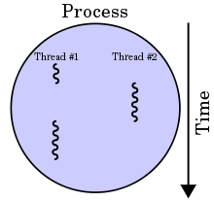
1. Thread

Slide 4
UI/Main Thread
OS creates a thread of execution to launch an app (e.g., activity), called "main." (A.K.A: UI thread)
https://developer.android.com/guide/components/processes-and-threads.html

Slide 5
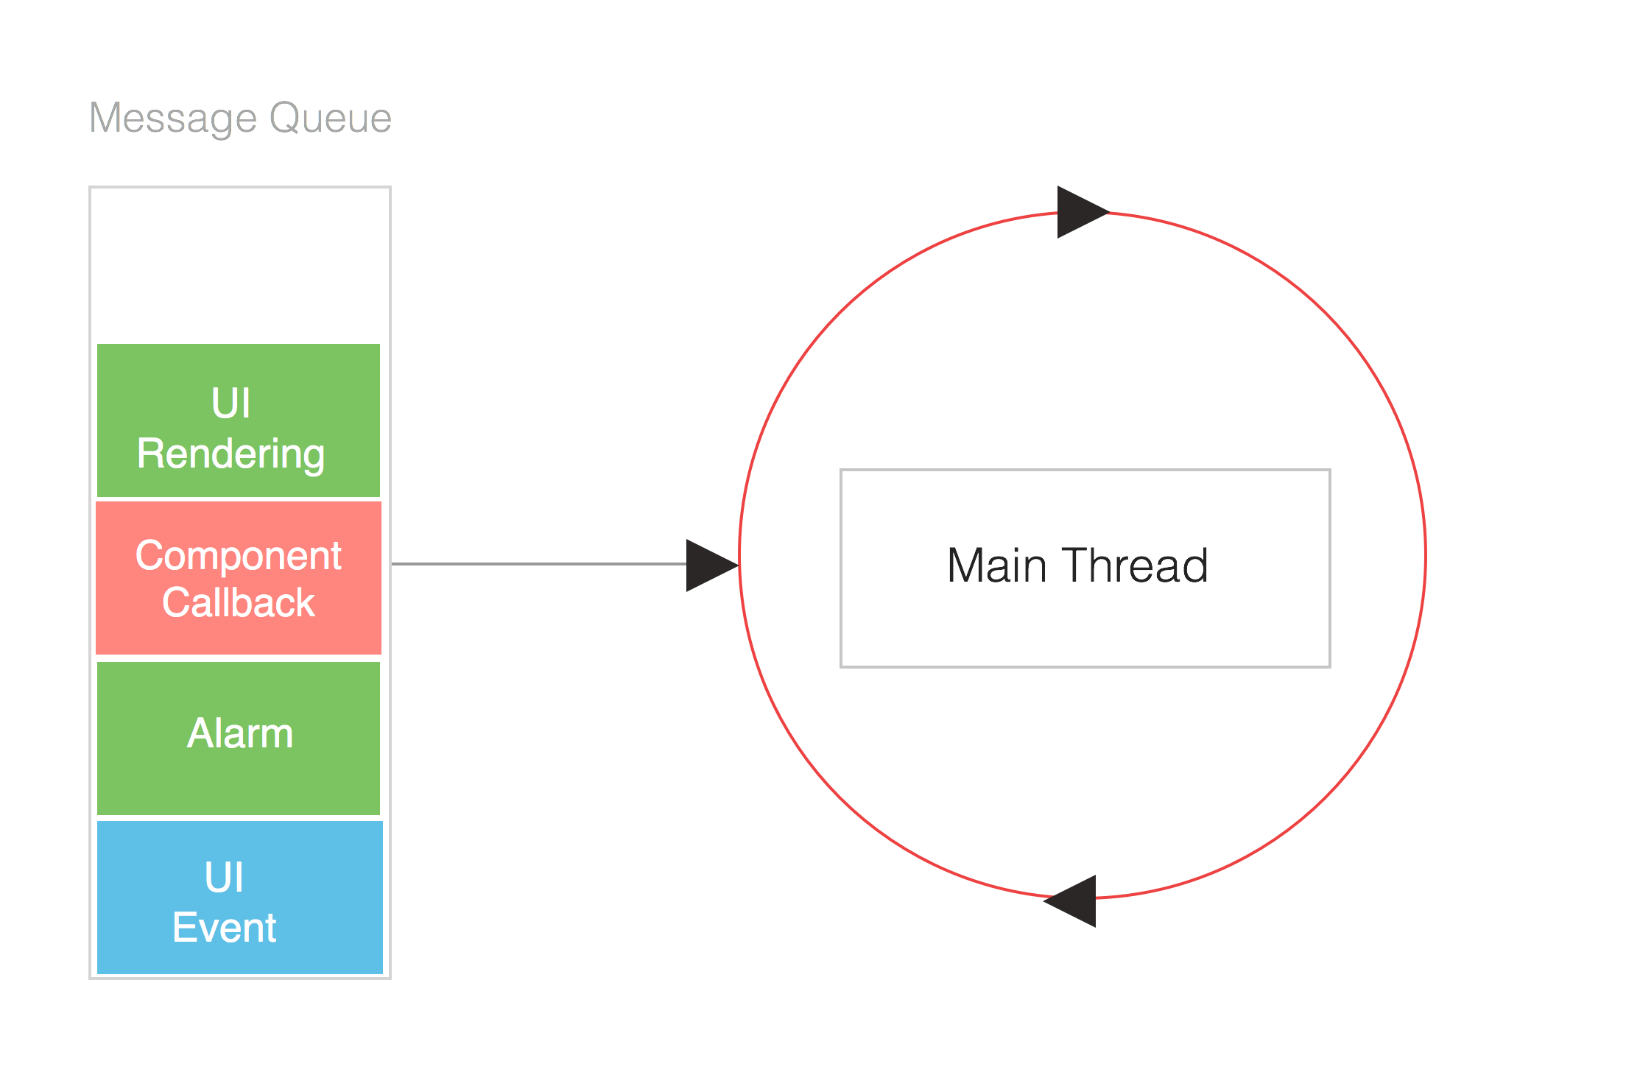
UI/Main Thread
http://hvasconcelos.github.io/images/main_thread_queue.png

Slide 6
UI/Main Thread
Even, a Service is running on the main thread.

Slide 7
Two important principles: 1. Do not block (overburden) the UI thread 2. Do not access UI from outside the UI thread

Slide 8
Don’t do heavy computation on UI thread:

Slide 9
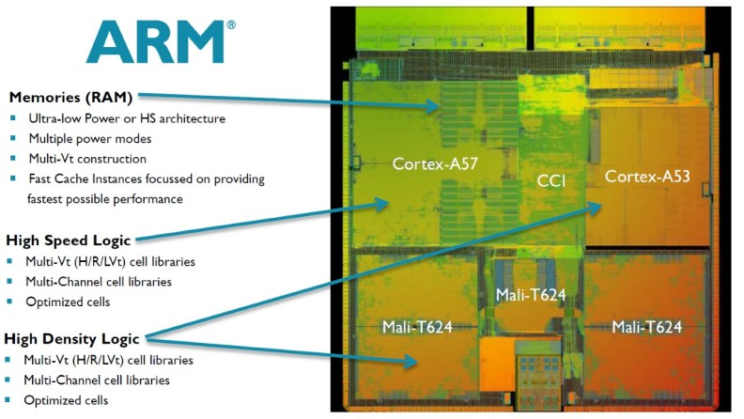
Mobile processor:
This processor die has many CPUs & GPUs
CPU
CPU
GPU
GPU
GPU

Slide 10
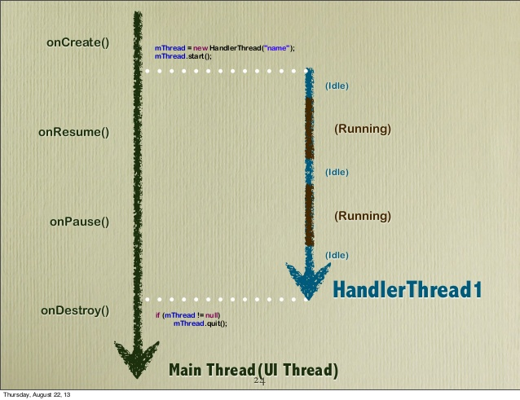
UI Thread In Multithreading
CPU 0
CPU 1

Slide 11
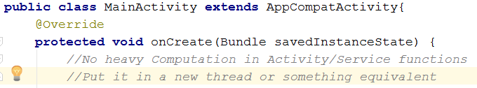
e.g., onCreate is on UI thread
(don’t overburden it)

Slide 12
A better design:
UI Thread
Result
Tasks
Worker Thread

Slide 13
Multithreading: Many ways
Thread and Runnable
HandlerThread
AsyncTask
IntentService
ThreadPoolExecutor
https://developer.android.com/training/multiple-threads/index.html

Slide 14
Thread and Runnable: 2 ways
class PrimeThread extends Thread
class PrimeRun implements Runnable
Put work in run() function

Slide 15
Thread and Runnable
Not run()
.start() to start a thread
To stop a thread properly, difficult
Mostly, a thread has a while loop and a temporarily cease execution (sleep time)
Extra slides on LMS will explain

Slide 16
Be careful with the thread context
If an activity/service creates a thread, the thread will continue to run when the activity/service dies or stops.
Activity/Service
Stop/Die
create
Thread
Run

Slide 17
Be careful with the thread context
If you don’t stop the thread, it shouldn’t use objects of the dead activity/service (Should eventually stop it. Otherwise, horrible)

Slide 18
Thread and Runnable
Demo
Look at the Logcat console

Slide 19
AsyncTask and IntentService
For offloading tasks from UI thread to a worker thread (they will create this).
You don’t need to manipulate a new thread for them.
Suitable for storage/network access

Slide 20
ThreadPoolExecutor
ThreadPoolExecutor can manage a number of concurrent tasks and a number of threads.
https://developer.android.com/reference/java/util/concurrent/ThreadPoolExecutor.html

Slide 21
HandlerThread
For more advanced multithreading with Handlers:
to schedule messages and runnables to be executed;
to enqueue an action to be performed on this new thread.

Slide 22
HandlerThread
A typical usage scenario is sensor data collection.
So let’s turn to sensors now.

Slide 23
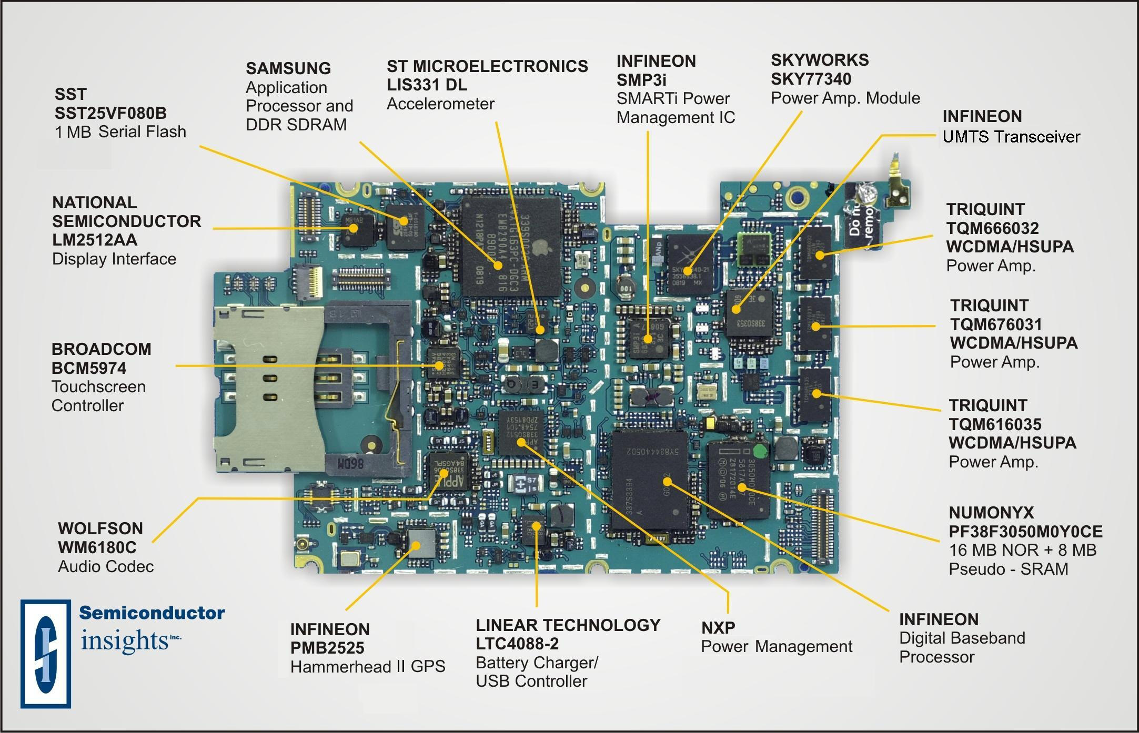
Phone Sensors

Slide 24
Android Sensors
Motion sensors
acceleration forces and rotational forces: accelerometers, gravity sensors, gyroscopes, and rotational vector sensors.
Environmental sensors
environmental parameters: ambient air temperature and pressure, illumination, and humidity. This category includes barometers, photometers, and thermometers.
Position sensors
physical position of a device: orientation sensors and magnetometers.

Slide 25
Android Location Service
Android puts all location sensors in a service API. (So it is easy to use)
Link: https://developer.android.com/guide/topics/location/index.html

Slide 26
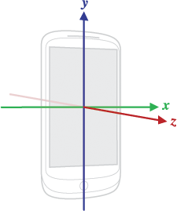
List of sensors for this lab
Accelerometer (movement, rate of change of velocity) (as a normal sensor)
Location (as a special API)
Right-handed coordinate system

Slide 27
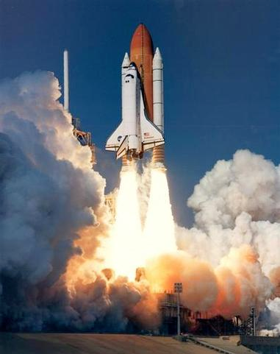
Motion sensors
An Android acceleration sensor measures the acceleration applied to the device, MINUS gravity.

Slide 28

Accelerometer
The phone is in the air, dropping, with gravity. The Android accelerometer reading is (0, 0, 0) m/s^2, if we don’t consider measurement error. (although physical acceleration is (0,0,-G), cf., Newton's Laws)

Slide 29
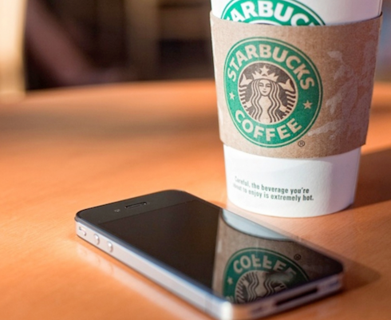
The phone is on the table, with the force given by the table and gravity. The accelerometer reading is (0, 0, G) m/s^2, if no measurement error. (G≈9.8 on our planet)

Slide 30

Example
Create an Android app to collect such data

Slide 31
Reference
https://developer.android.com/reference/android/hardware/SensorManager.html
https://developer.android.com/reference/android/hardware/SensorEventListener.html

Slide 32
Collect sensor data
1. Implement the interface SensorEventListener in an Activity or a Service (mostly using Service).
2. Initialise SensorManager
3. Implement onAccuracyChanged() and onSensorChanged() function

Slide 33
Using a HandlerThread
Sensor data collection may happen very often. So It is better to have a new thread to do this.
Demo using a HanderThread

Slide 34
Do computation in another thread
(Your Kalman Filter goes here!)
The data collection HandlerThread only responds to new sensor data.
Computation needs a more stable and manageable thread.
Demo doing computation on a new thread.

Slide 35
Demo: continuous sensing
UI Thread
Data Collection Thread
Data Processing Thread

Slide 36
Location Sensing
This is different from other sensors.
You need a LocationManager
A Service does the low-level sensing : Context.LOCATION_SERVICE
Register a LocationListener

Slide 37
Permission Check For Location
Location Sensing requires Permission from users.
API 23 or above needs runtime Permission Check
Notes:
<uses-feature android:name="android.hardware.location.network" /> <uses-feature android:name="android.hardware.location.gps" />

Slide 38
Permission of Feature Usage
API 21+ requires explicit feature specification
<uses-feature android:name="android.hardware.location.network" />
<uses-feature android:name="android.hardware.location.gps" />

Slide 39
Demo For Location Sensing

Slide 40
Google Play Also Has Localisation
Use the Class FusedLocationProviderClient
https://developers.google.com/android/reference/com/google/android/gms/location/FusedLocationProviderClient
Not Available on devices without Google Play

Slide 41
Exercise: 1. Create a Service collecting sensor data. 2. Put data collection in a HandlerThread 3. Do computation in another thread

Slide 42
More learning directions: 1. Try to process raw data. 2. Design Content Providers to store/read data. 3. Use a server to support apps, e.g., using Firebase/Azure/AWS.

Slide 43
What About Next Week?
Graphics and Canvas
Game Design
Game Engines and Unity

Slide 44
See you next week COMP 90018
Tutorial on Android Development
Chu Luo, Ransi De Silva
chu.luo@unimelb.edu.au
ransidesilva@gmail.com

